Slide 1


Neighborhood Final Project

Slide 2
Introduction/Business Problem
Toronto is a diversified and multi-culture city. There are lots of business potentials regarding different culture background and traditions. In order to open a new business successfully, we need to explore the neighborhood and have some insight about the target area and people.

Slide 3
Data
I use the Wikipedia page of Canada’s postal code list to create a Toronto neighborhood dataframe. Then use the latitude and longitude of given borough or neighborhood to explore the most common venues in Forsquare API.

Slide 4
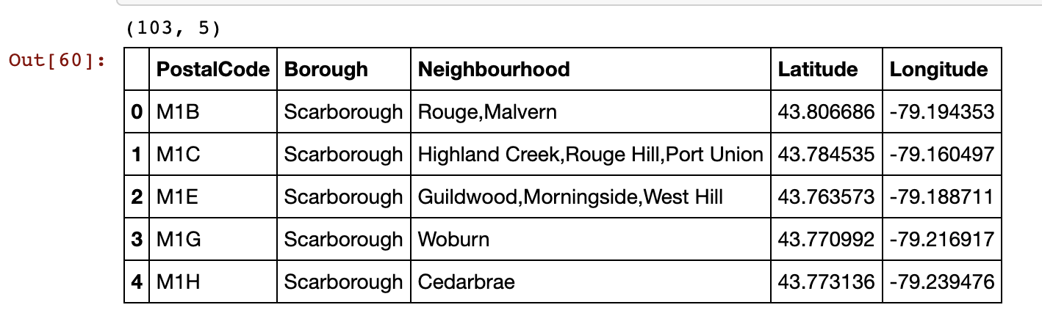
Methodology
Scrape a Wikipedia page to get the postcode, borough and neighborhood of Toronto.
Merge with coordinates.

Slide 5
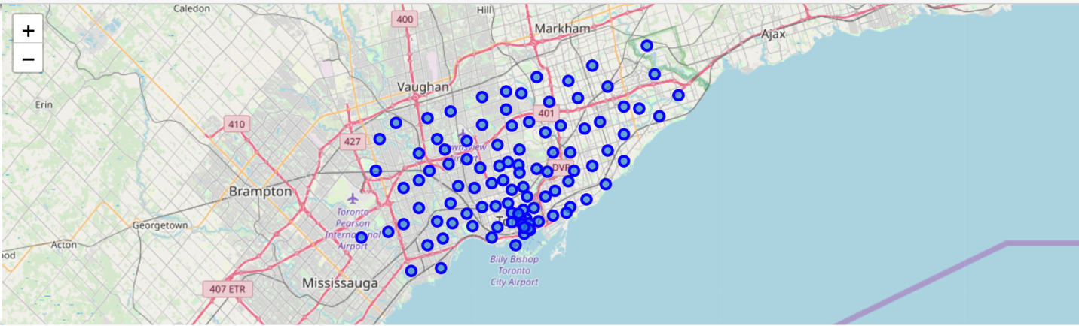
Methodology
Create a Toronto map using Folium.

Slide 6
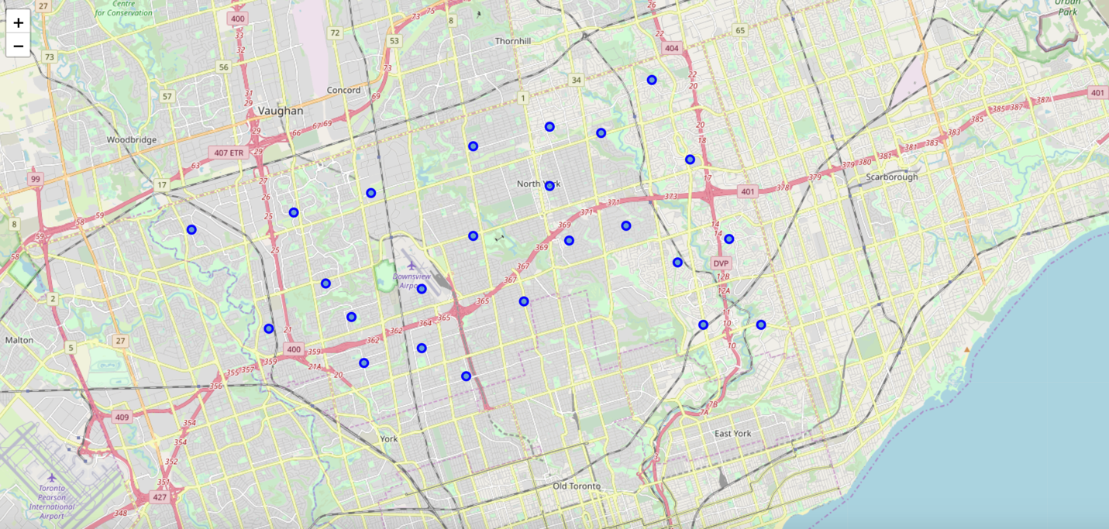
Methodology
Focus on North York borough and create a map using Folium.

Slide 7
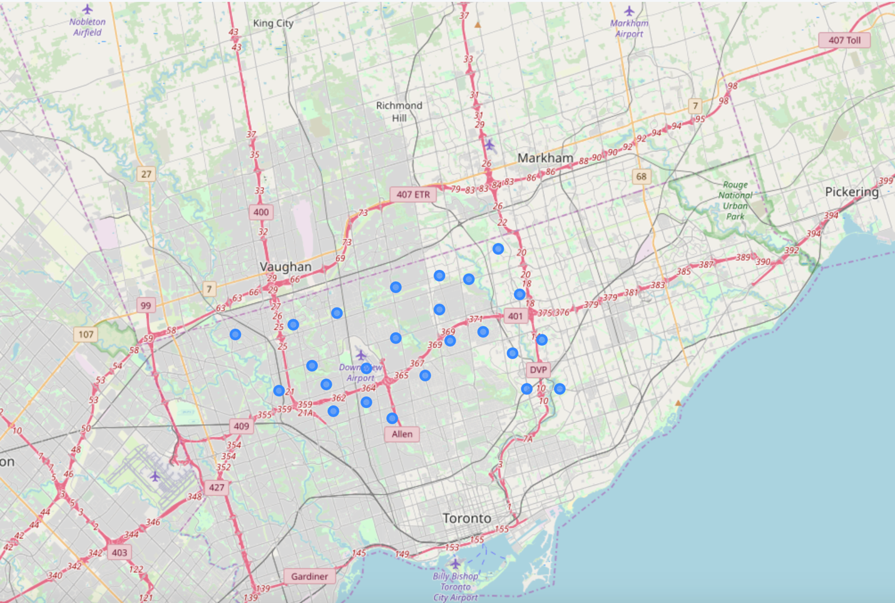
Methodology
Run k-means to cluster the neighborhood into 5 clusters and use the folium map to visualize the clusters.

Slide 8
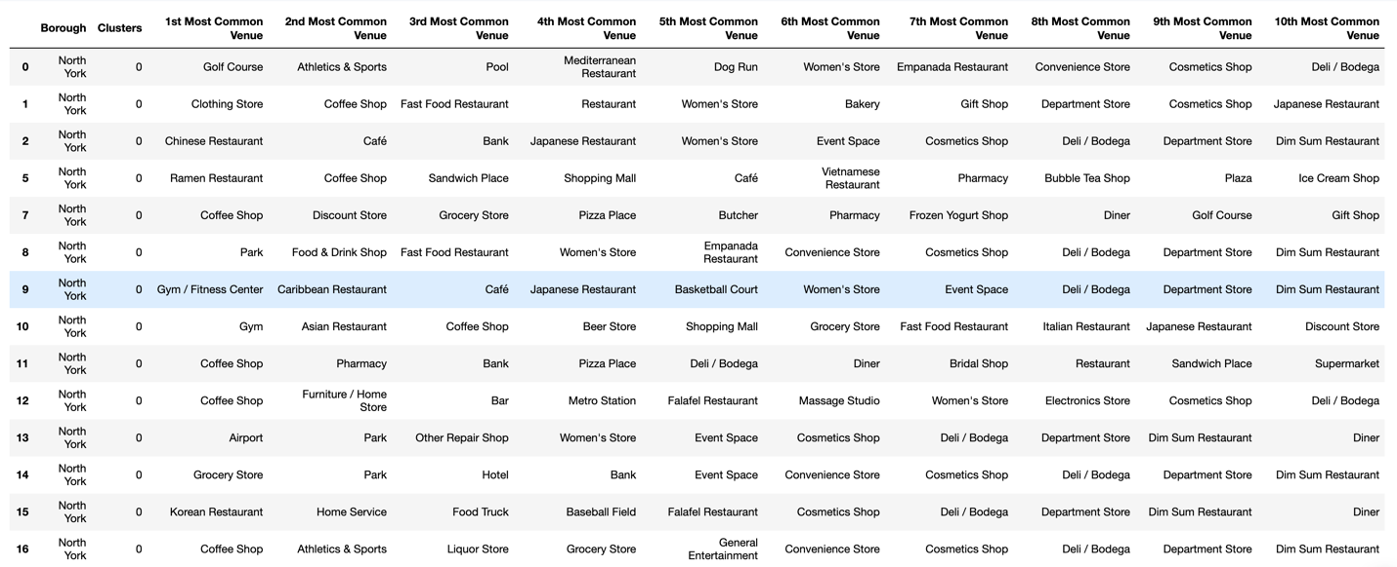
Results
Look at 5 clusters individually:
Cluster 1

Slide 9
Results
Cluster 2

Slide 10
Results
Cluster 3

Slide 11
Results
Cluster 4

Slide 12
Results
Cluster 5

